Slide 1

DATA SCIENCE
Prof. Jean Paul Barddal

Slide 2
DATA VISUALIZATION

Slide 3
Data types and visualizations
To determine the type of plot we should use, we need to check:
the number and
The types of the variables to be presented

Slide 4
UNIVARIATE ANALYSIS

Slide 5
Univariate plots
There are not many types of visualizations for univariate plots
Most cases can be reported with histograms or bar plots
Main types of visualization:
Histogram/KDE plots: numeric variable
Bar plot: categorical variable
Box-plot: numeric variable
Pie-charts: avoid them! https://medium.com/@clmentviguier/the-hate-of-pie-charts-harms-good-data-visualization-cc7cfed243b6

Slide 6
Let’s code
Let’s use seaborn to plot different types of univariate visualizations
sns.distplot
sns.countplot
sns.boxplot
sns.violinplot

Slide 7
BIVARIATE ANALYSIS

Slide 8
Bivariable plots
Goal: verify potential relations in data
The definition of which type of plot should be used depends on the types of variables involved
Scatterplots: two numeric variables
Lineplots: two numeric variables, usually one depicting time
Box-plots and violin-plots: one categorical variable and one numeric variable
Heatmaps: 2 numeric variables, 2 categorical variables

Slide 9
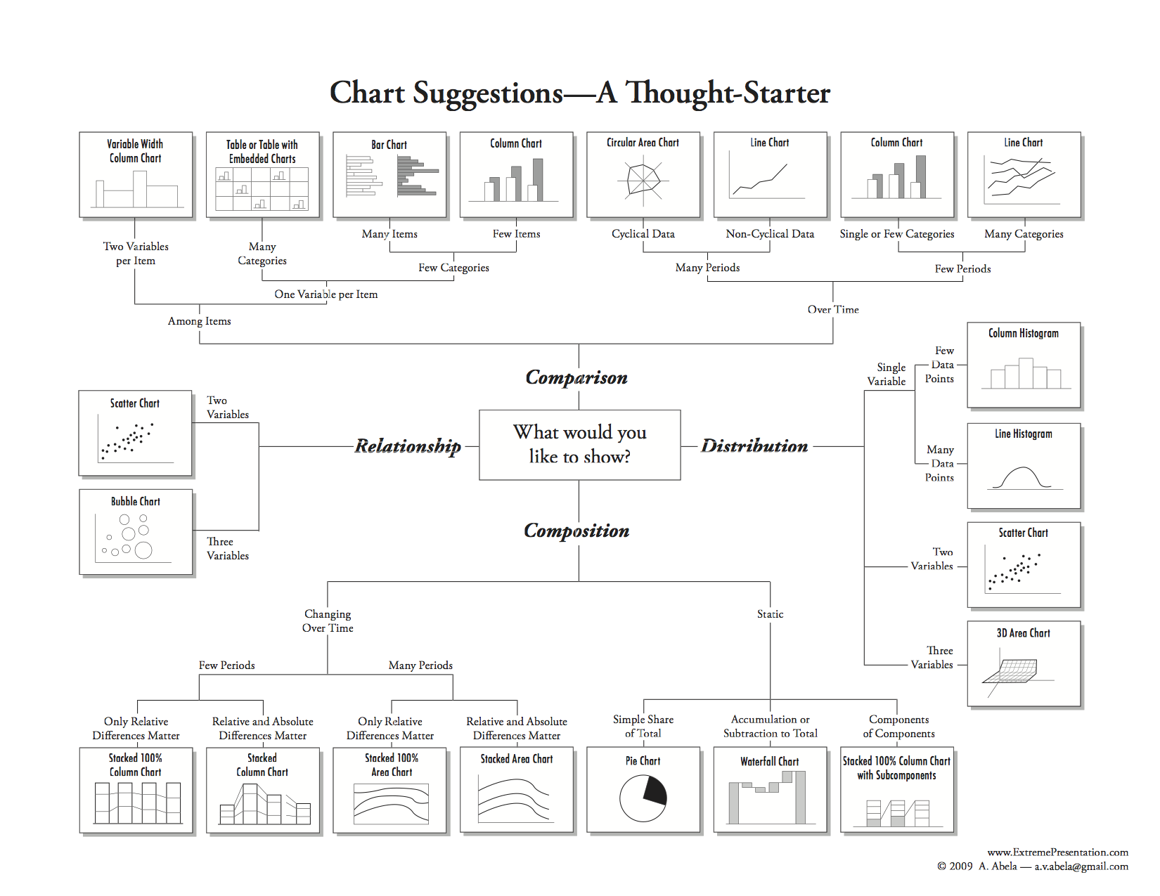
What kind of plot should I build?

Slide 11
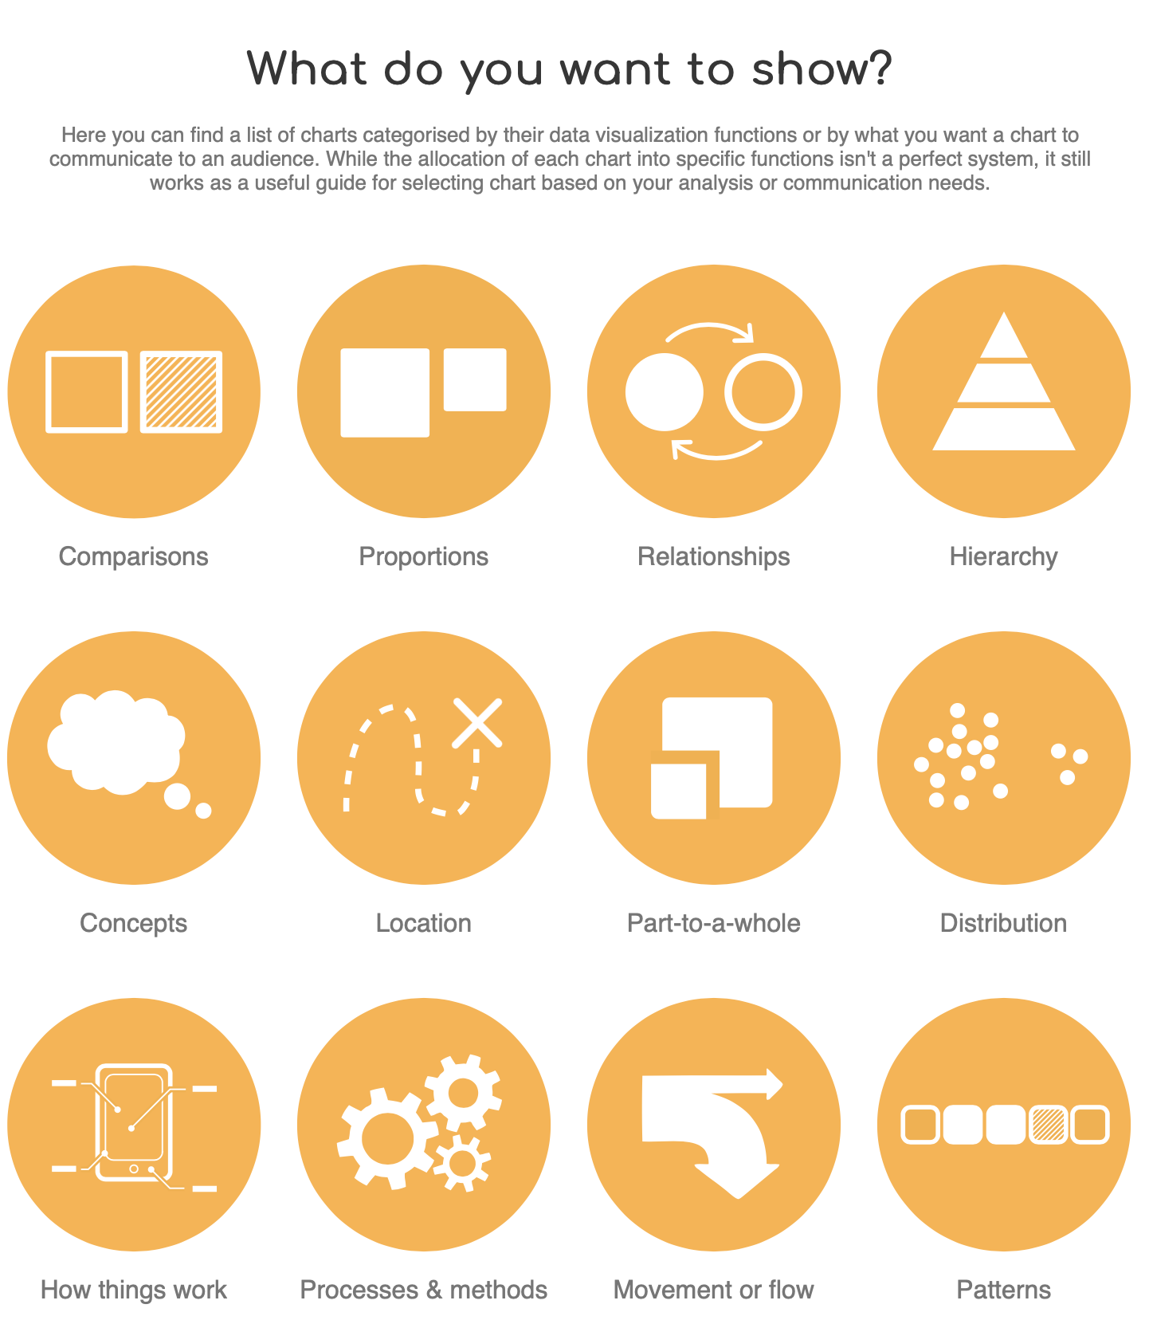
Important links
Datavizcatalogue
https://datavizcatalogue.com
“Search by function” option
Data-to-viz
https://www.data-to-viz.com
Python Graph Gallery
https://python-graph-gallery.com

Slide 12
Design CHOICES

Slide 13
Overplotting
Issue that araises when there are many data points that share the same region in the plot
Ways to overcome overplotting:
Jitter
Marker size
Transparency
Density
Sampling
Filtering
Clustering

Slide 14
Hands-on
Let’s code of the examples of bivariate plots
And let’s also overcome overplotting using the techniques mentioned earlier.

Slide 15
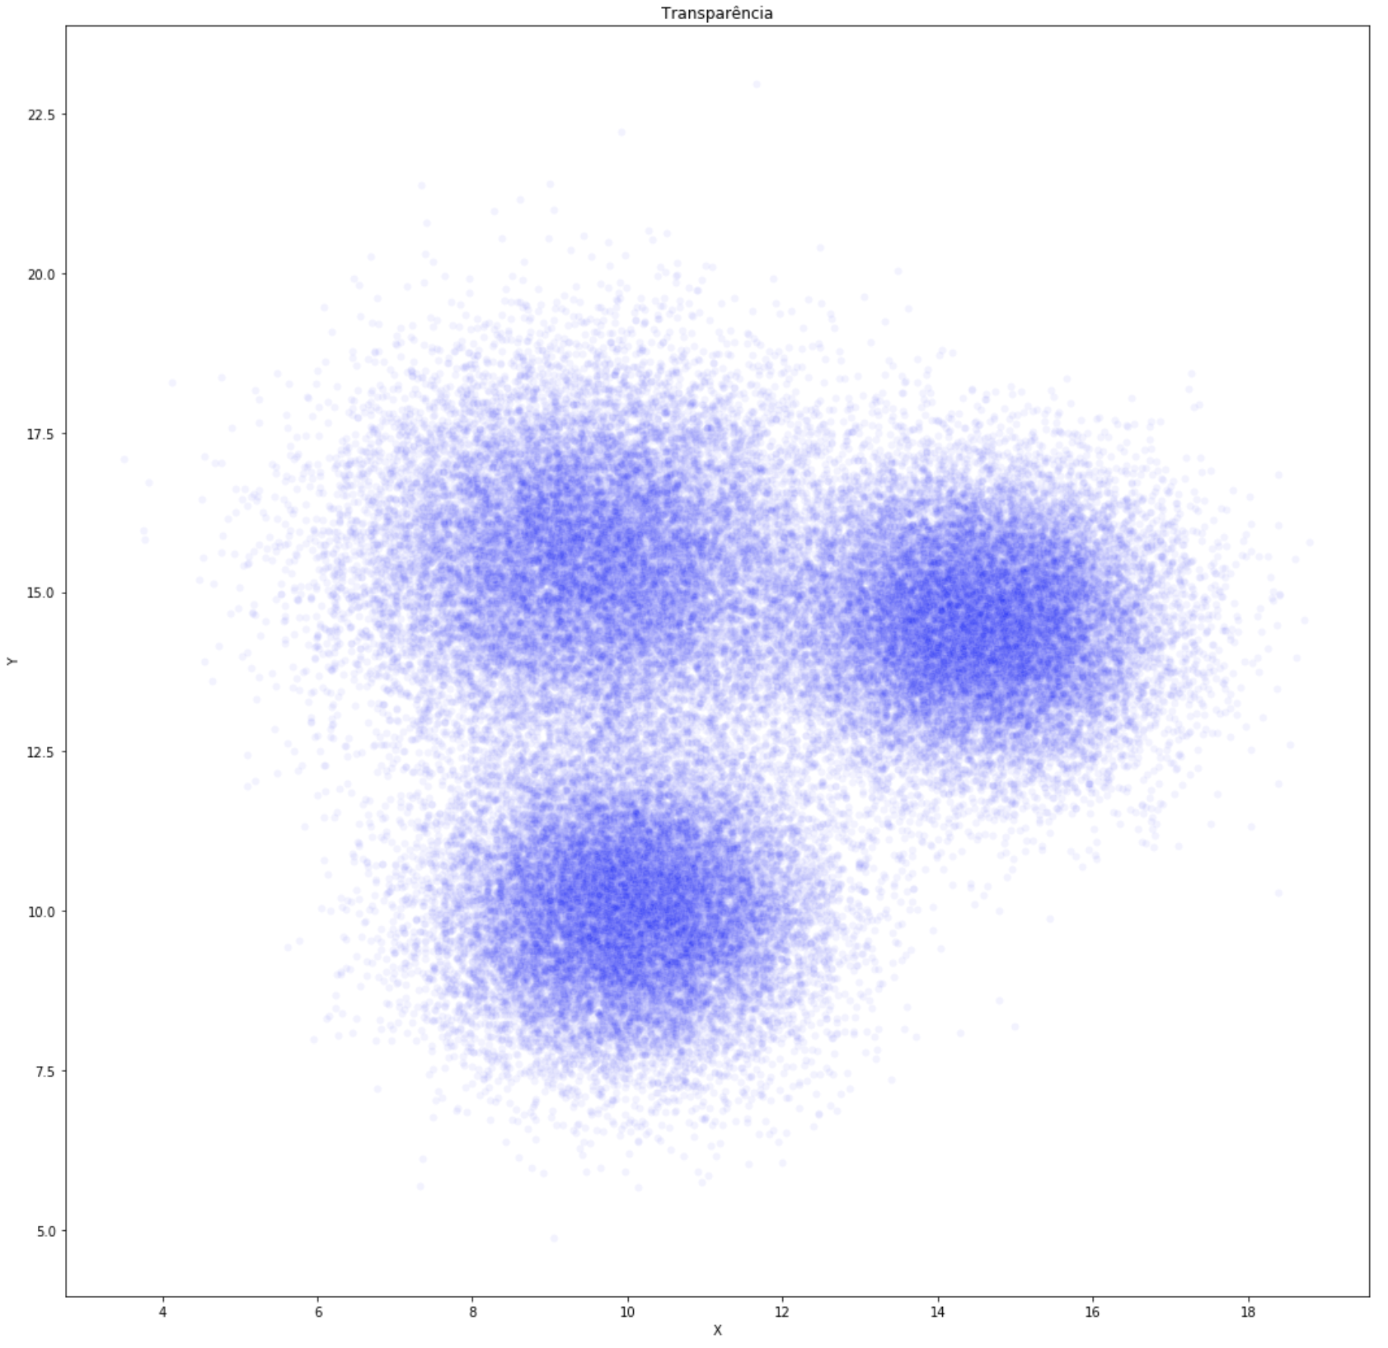
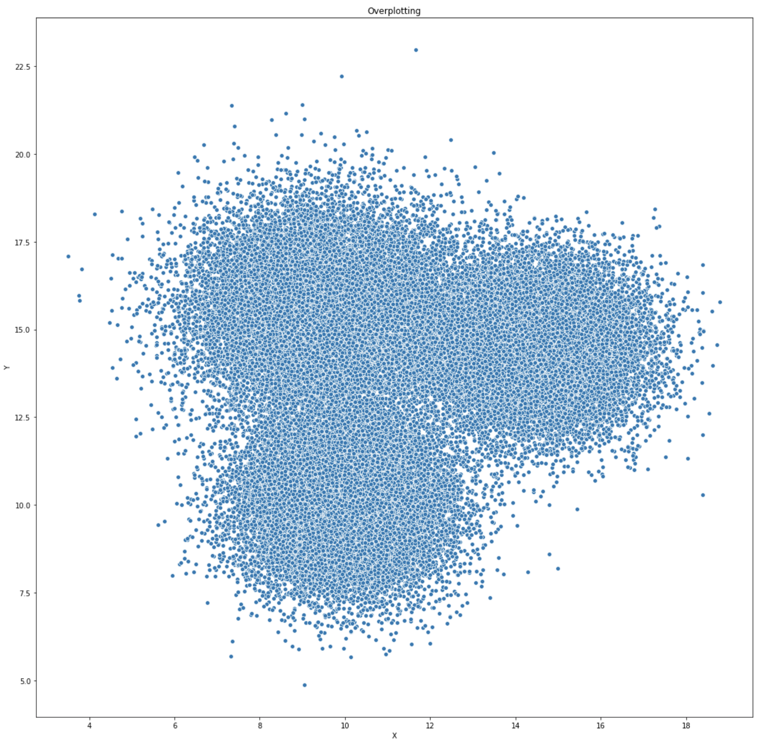
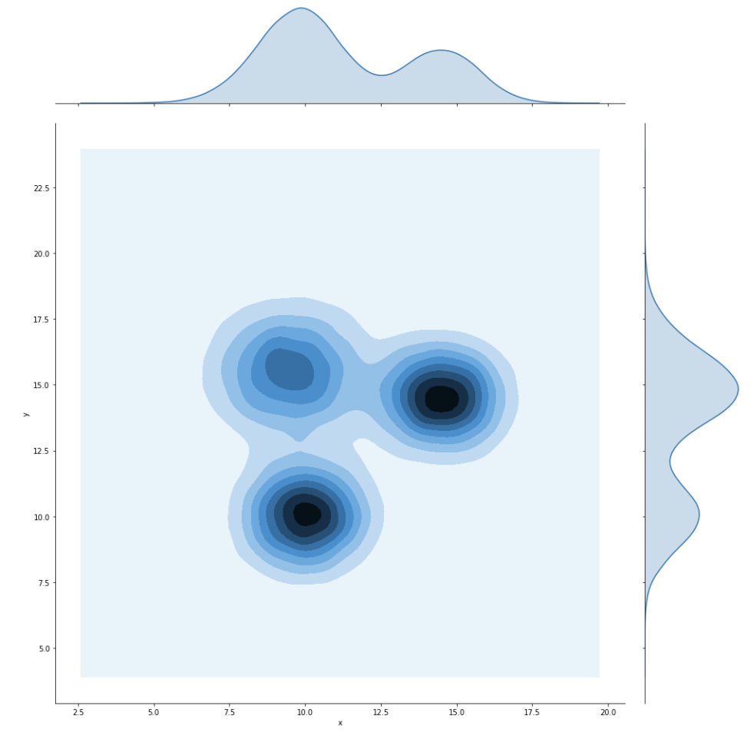
Overplotting examples

Slide 16
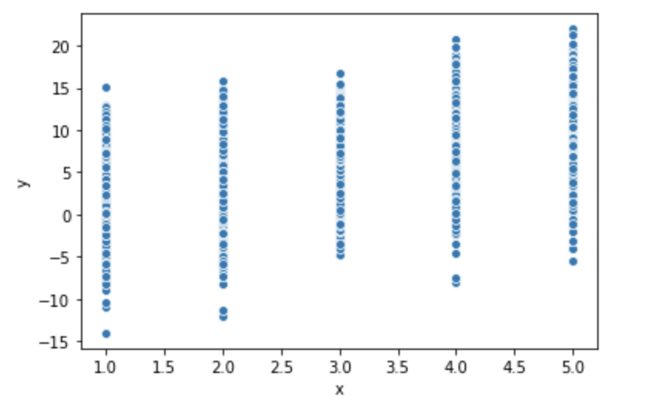
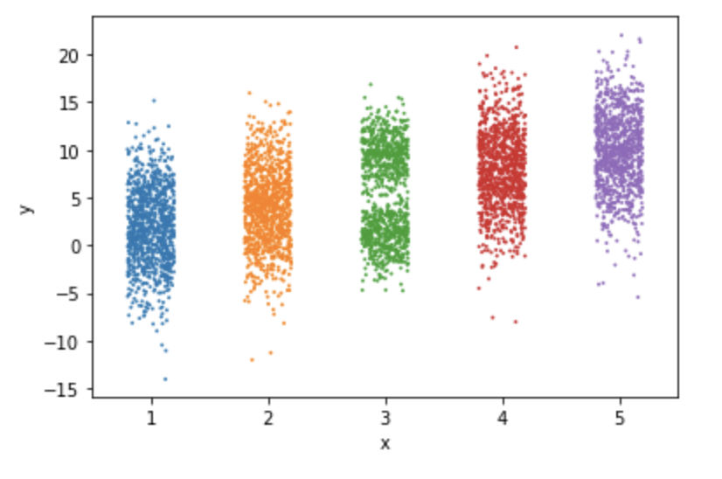
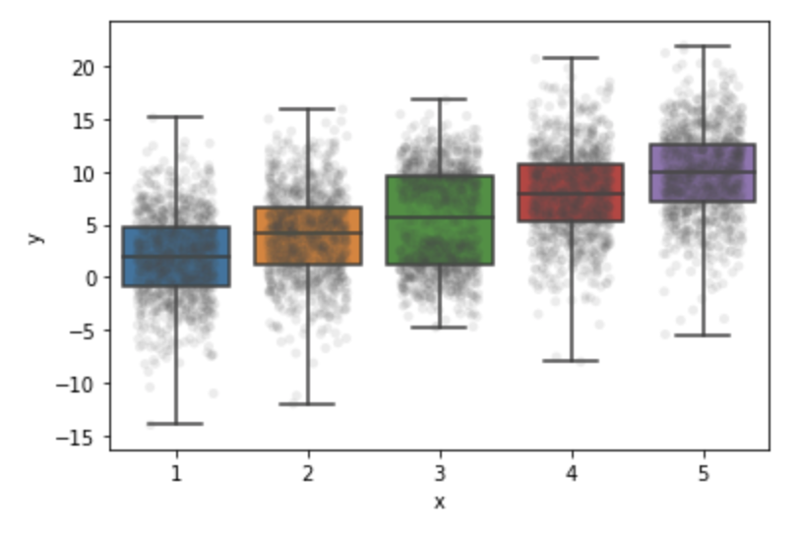
Numeric variable vs. categorical variable

Slide 17
Take the remainder of today’s time to work on your project Keep in mind that in less than a month you need to deliver this initial analysis

